Slide 1
THE IMPACT OF DIGITAL TRANSFORMATION IN ONLINE MARKETING
AVINASH R
LEKHA SRI POOJA V
TANUSHREE R

Slide 2
PROBLEM STATEMENT
To identifies the potential areas of digital marketing that are underutilized, the needs of the business that digital marketing can address and the priorities to be given to those areas according to their importance

Slide 3
OBJECTIVE
To investigate the impact of digital transformation and how it is important for both consumers and marketers
To find out whether gambling is influenced by advertisements and Money investment through online.
To find out which platform shows frequent advertisements through which people are influenced.

Slide 4
METHODS AND TOOLS USED
METHODS USED
PCA
MANOVA
Hierarchical Clustering
TOOL USED
R

Slide 5
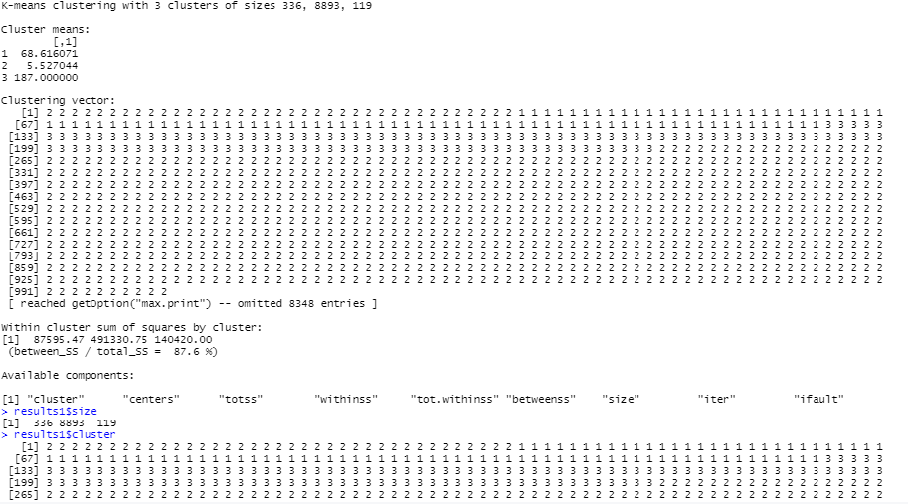
RESULTS AND INTERPRETATION
K means clustering:
The sum of squares of the second cluster is the highest, hence it is the cluster with maximum dissimilarity.

Slide 6
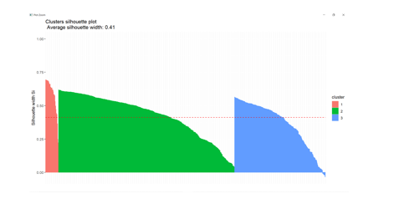

Slide 7
MANOVA:
By using MANOVA (Pillai Trace) we can identify whether the level of impact of your well being and hours spend in social media affects number of social media platforms or not. Here p value is less than 0.5 which is 7.693e-10. Hence we can say that it is significant.
Therefore Gambling is influenced by advertisement and money investment through online.

Slide 8


Slide 9
PCA:
PC1 and PC2 has higher variability
In PC1, Google, Instagram, Television and posters provide more variation to the original data.
In PC2, Facebook, Instagram, Television, and Mobile application provide more variation to the original dataset.
In graph and Scree plot, PC1 and PC2 shows more variance so naturally, as said before, it will be taken into consideration.
After applying kmeans clustering and dimensionality reduction, both the graphs are similar.

Slide 10
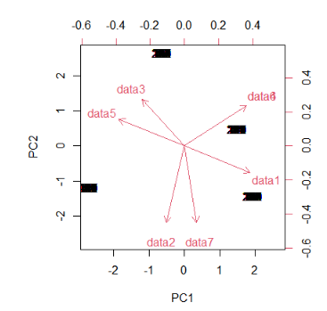
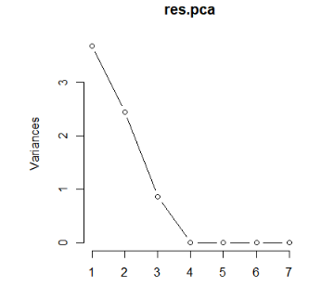

Slide 11
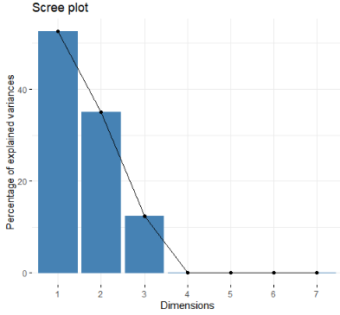
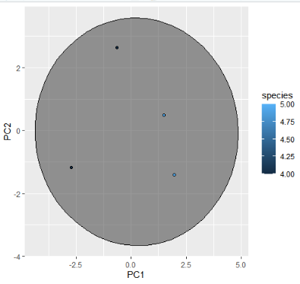

Slide 12
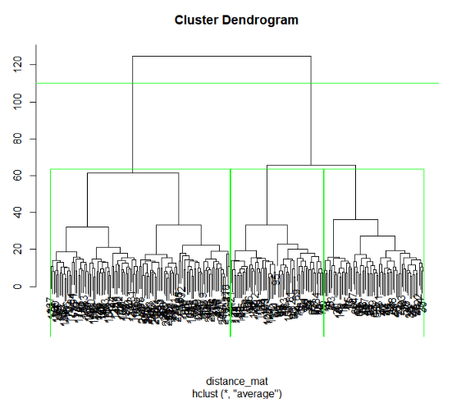
Hierarchical Clustering
The cluster dendrogram is plotted using Euclidean distance. Each of data points is considered as a clustered among groups together to finally form a single cluster in hierarchical order

Slide 13


